Slide 1
Lesson 6
E115 – Programming and Data analysis

Slide 2
Lesson objectives
At the end of the lesson, you should be able to:
Explain the meaning of “correlation”
Plot an X-Y scatter chart to graphically show the relationship between 2 variables
Calculate the correlation coefficient for 2 variables using Excel correl() function
Identify the direction and strength of correlation via X-Y scatter charts and correlation coefficients
Use Data Analysis ToolPak in Excel to generate correlation coefficients for multiple pairs of data sets
Use Data Analysis ToolPak in Excel to generate histogram based on certain bin range

Slide 3
Some interesting findings
Students who spend more time studying tend to earn higher grades
People who get less sleep tend to have more body mass
People with low self esteem are more likely to suffer from depression
In major big cities, when ice cream consumption increases, crime rate increase
How can people draw these conclusions?
Notes:
Try to find a youtube video to replace this slide

Slide 4
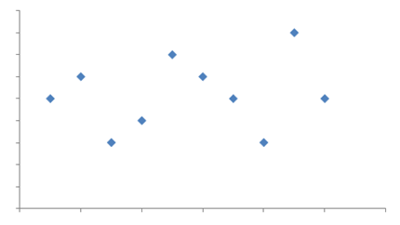
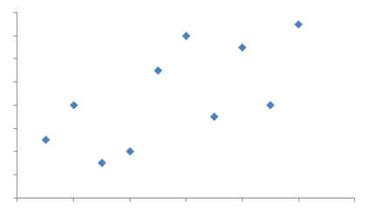
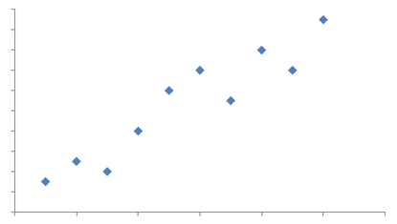
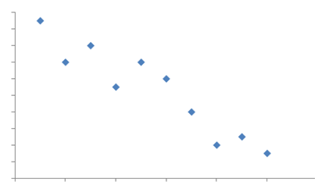
Relationships can be presented in scatter plots
Y
Graph A
Graph B
Y
X
X
Y
Graph C
Y
Graph D
X
X
Can you describe the relationship between the variables X and Y?

Slide 5
What is Correlation ?
Correlation measures the strength of association between two variables and the direction of the relationship.
Correlation analysis is the study on how variables are correlated.
E.g. A person’s arm length and height may be correlated. Longer-armed people tend to be taller than shorter-armed people.
Correlation ≠ Causation
E.g. A person’s arm length and height may be correlated. However, the person is tall not because he has long arms and the person has long arms not because he is tall.

Slide 6
Detecting correlation
A small study is conducted involving 17 infants to understand the correlation between gestational age at birth, measured in weeks, and birth weight, measured in grams.
An X-Y scatter chart is able to help in visualizing the relationship.
Infant ID# | Gestational Age (wks.) | Birth Weight (g)
1 | 34.7 | 1895
2 | 36.0 | 2030
3 | 29.3 | 1440
4 | 40.1 | 2835
5 | 35.7 | 3 090
6 | 42.4 | 3827
7 | 40.3 | 3260
8 | 37.3 | 2690
9 | 40.9 | 3285
10 | 38.3 | 2920
11 | 38.5 | 3430
12 | 41.4 | 3657
13 | 39.7 | 3685
14 | 39.7 | 3345
15 | 41.1 | 3260
16 | 38.0 | 2680
17 | 38.7 | 2005

Slide 7
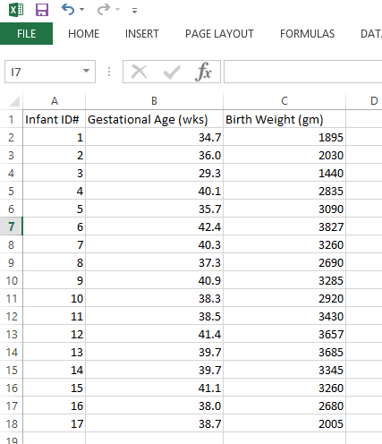
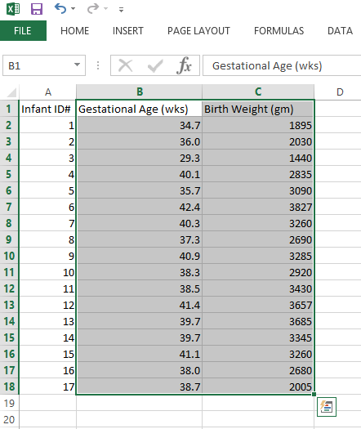
Do-it-with-me: Prepare the Data (1)
Step 1: Copy the collected data into Excel
Step 2: Select the column B and column C with headers
Note: Column A is not required

Slide 8

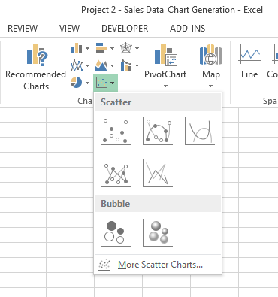
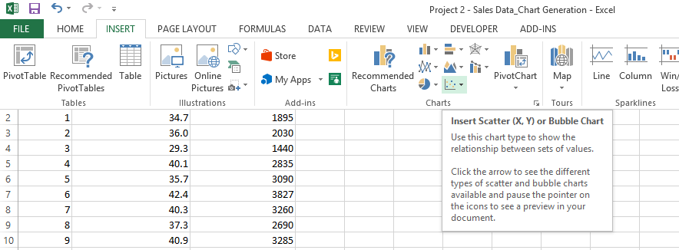
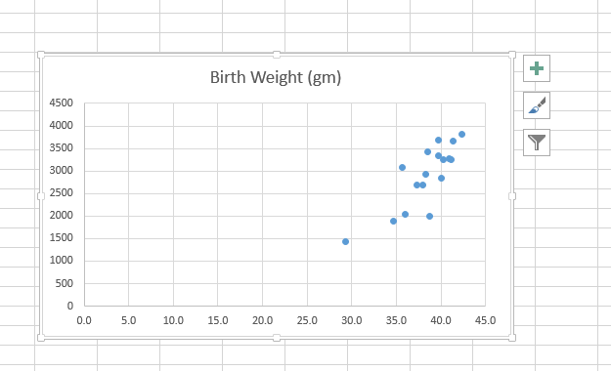
Do-it-with-me: Plot X-Y scatter chart (2)
Step 3: Go to the Tab “Insert”, find and click the icon in the section of “Chart”
Step 4: Choose the first Scatter chart and click
Scatter chart appears in your Excel worksheet
1
2

Slide 9
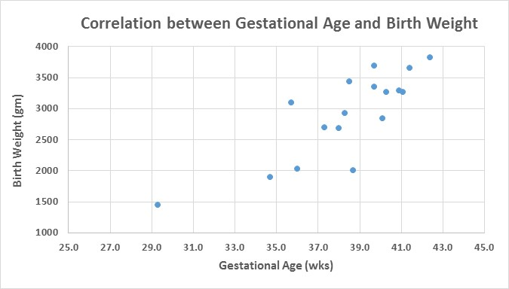
Do-it-by-yourself: Formatting the chart (3)
Step 6: Change the minimum and maximum value of X and Y axes
Step 7: Add the axis titles for X and Y axes
Step 8: Change the chart title
Step 9 (Optional): Format the chart on your preference (style of chart, color, font, font size, data labels, etc.)

Slide 10
Exercise
Plot an X-Y scatter chart for the following data
Amount of Ice Cream consumed in a month (kg) | No. of Criminal Incidents
702 | 70
429 | 38
462 | 64
287 | 32
399 | 82
651 | 96
922 | 112
880 | 110
820 | 103
208 | 24
719 | 73
800 | 83

Slide 11
Exercise - Answer

Slide 12
What conclusion drawn for different patterns ?
1. Strong, Positive Correlation
2. Strong, Negative Correlation
3. No Correlation
4. Weak, Positive Correlation

Slide 13
Directions of correlations
Positive correlation
A positive correlation exists when one variable decreases as the other variable decreases, or one variable increases while the other increases.
E.g. Amount of time spent on writing code, and E115 module grade
Negative correlation
A negative correlation exists when one variable decreases as the other variable increases, or one variable increases while the other decreases.
E.g. Number of absences in class, and GPA
No correlation
No obvious pattern is found between two variables
E.g. birthday and intelligence

Slide 14
Conclusion to the example
Birth Weight and Gestational Age is positively correlated.
Strong or weak?

Slide 15
Mathematical measure of correlation
Correlation Coefficient, Pearson’s r, is used to quantify the correlation between two continuous variables.
Pearson’s r ranges between -1 and +1.
The sign (+/-) of the correlation coefficient indicates the direction of the association (positive or negative)
The absolute value of the correlation coefficient indicates the strength of the association. (strong or weak ). So, a correlation of –0.70 is stronger than a correlation of +0.5
Strong correlation between 2 variables does not mean that one variable causes the other variable.
Notes:
Pearson’s r = $\frac{n \sum{XY −\sum{X \sum{Y}}}}{\sqrt{\left[n\sum{X^{2}}−{\left(\sum{X}\right)}^{2}\right]\left[n\sum{Y^{2}}−{\left(\sum{Y}\right)}^{2}\right]}}$

Slide 16
Rule of thumb
Absolute value of r | Interpretation
0.8 to 1.0 | Very strong relationship
0.6 to 0.8 | Strong relationship
0.4 to 0.6 | Moderate relationship
0.2 to 0.4 | Weak relationship
0 to 0.2 | No relationship

Slide 17
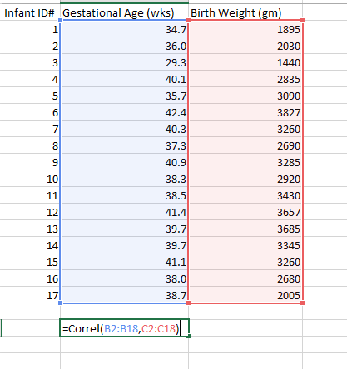
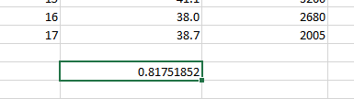
Do-it-with-me: Excel Function - Correl(array1, array 2)
Still use the example of Age and Weight study and go back to the data prepared before
Step 1: type the formula, “=Correl()” at any empty cell
Once you type the 1st bracket, Excel will automatically prompt you to put in 2 arrays as input parameters
Step 2: Select the range “B2:18” as the 1st array, “C2:C18” as the 2nd array, then press “enter”
The correlation coefficient r will be shown, r = +0.8175
r>0 and r>0.8, strongly positive correlated
From the study, we can strongly believe the longer weeks a baby stays inside its mummy’s body, the heavier it will be

Slide 18
Exercise
Calculate the correlation coefficient for the following data using the Excel function correl()
Amount of Ice Cream consumed in a month (kg) | No. of Crime Incidents
702 | 70
429 | 38
462 | 64
287 | 32
399 | 82
651 | 96
922 | 112
880 | 110
820 | 103
208 | 24
719 | 73
800 | 83

Slide 19
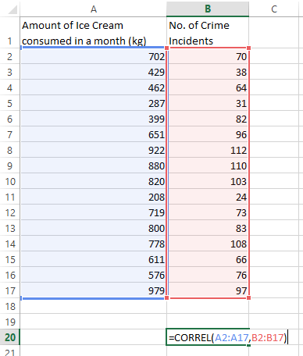
Exercise - Answer
r = 0.878

Slide 20
What if there were more than 2 variables?
ID# | Gestational Age (wks.) | Birth Weight (gm) | Birth Height (mm) | Head circumference (mm)
1 | 34.7 | 1895 | 478 | 322
2 | 36.0 | 2030 | 490 | 325
3 | 29.3 | 1440 | 465 | 315
4 | 40.1 | 2835 | 489 | 338
5 | 35.7 | 3090 | 493 | 344
6 | 42.4 | 3827 | 528 | 385
7 | 40.3 | 3260 | 483 | 379
8 | 37.3 | 2690 | 511 | 344
9 | 40.9 | 3285 | 532 | 365
10 | 38.3 | 2920 | 523 | 370
11 | 38.5 | 3430 | 492 | 367
12 | 41.4 | 3657 | 504 | 367
13 | 39.7 | 3685 | 527 | 390
14 | 39.7 | 3345 | 518 | 330
15 | 41.1 | 3260 | 508 | 375
16 | 38.0 | 2680 | 493 | 358
17 | 38.7 | 2005 | 478 | 356

Slide 21
Excel: Data Analysis ToolPak
Excel has a full list of tools which support more complex data analysis, mainly statistical or engineering analyses
Analysis ToolPak
ANOVA | Moving Average
Correlation | Random Number Generation
Covariance | Rank and Percentile
Descriptive Statistics | Regression
Exponential Smoothing | Sampling
F-test Two-Sample for Variances | t-Test
Fourier Analysis | Z-Test
Histogram | -

Slide 22
Load and Activate the Analysis ToolPak
1.Click the File tab, click Options, and then click the Add-Ins category.
If you're using Excel 2007, click the Microsoft Office Button Office button image , and then click Excel Options
2.In the Manage box, select Excel Add-ins and then click Go.
If you're using Excel for Mac, in the file menu go to Tools > Excel Add-ins.
3.In the Add-Ins box, check the Analysis ToolPak check box, and then click OK.
If Analysis ToolPak is not listed in the Add-Ins available box, click Browse to locate it.
If you are prompted that the Analysis ToolPak is not currently installed on your computer, click Yes to install it.

Slide 23
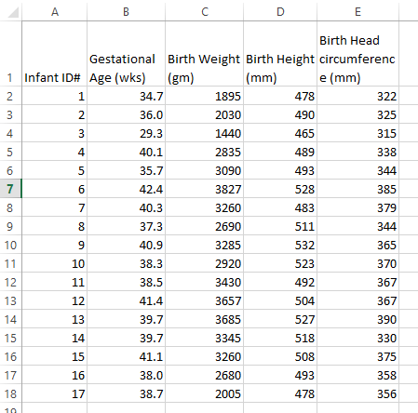
Do-it-with-me: Prepare the Data (1)
Step 1: Copy the collected data into Excel

Slide 24
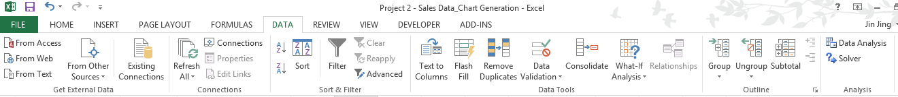
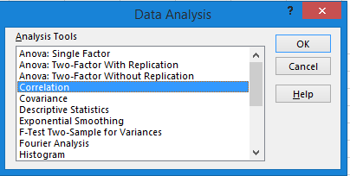
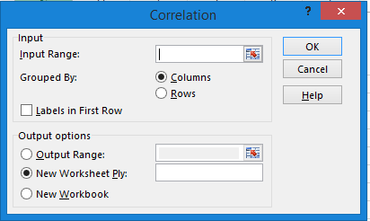
Do-it-with-me: Data Analysis → Correlation
Step 2: Go to the Tab “Data”, clink “Data Analysis” at the right top corner
1
2
Step 3: Window “Data Analysis” will pop up, select “Correlation” and click “Ok”.
Step 4: Window “Correlation” will pop up

Slide 25
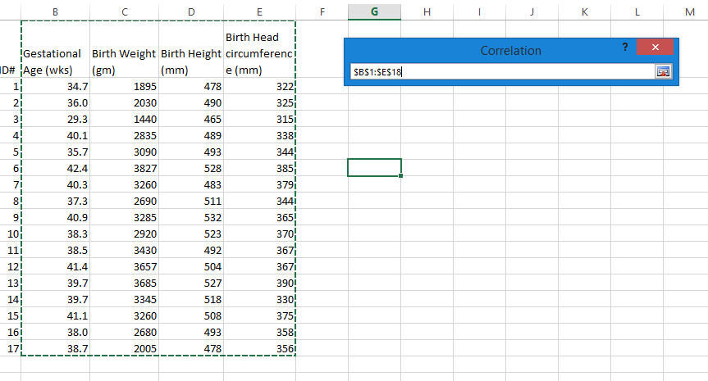
Do-it-with-me: Correlation Analysis
Step 5: Select Input Range by click the button shown in the red circle
Step 6: Select the data range “B1: E18” by covering the cells from B1 to E18
Step 7: click the button in the red circle again to allow the range being selected
Step 8: Grouped by “Column”
Step 9: Tick “Labels in first row”
Step 10: Output Option is “Output Range”. Click the button in the red circle and select a blank cell in the current worksheet as the place to put the correlation analysis result
Step 11: Click “Ok”

Slide 26
Correlation Analysis Matrix
The correlation coefficients for any pair of variables are shown in a matrix shown below
What conclusions you can draw from the results?
Are the variables positively or negatively correlated?
Which 2 variables have the strongest correlation?
Which 2 variables have the weakest correlation?

Slide 27
Exercise
Here is a study for a set of 3 variables for each of 20 participants on recovery from a head injury.
Obtain the correlation coefficient matrix using Data Analysis ToolPak
Age at Injury | Level of Treatment | 12-Month Treatment Score
25 | 1 | 78
16 | 2 | 66
8 | 2 | 78
23 | 3 | 89
31 | 4 | 87
19 | 4 | 90
15 | 4 | 98
31 | 5 | 76
21 | 1 | 56
26 | 1 | 72
24 | 5 | 84
25 | 5 | 87
36 | 4 | 69
45 | 4 | 87
16 | 4 | 88
23 | 1 | 92
31 | 2 | 97
53 | 2 | 69
11 | 3 | 79
33 | 2 | 69

Slide 28
Exercise - Answer
Result
 | Age at Injury | Level of Treatment | 12-Month Treatment Score
Age at Injury | 1
Level of Treatment | 0.0557 | 1
12-Month Treatment Score | -0.1543 | 0.3891 | 1

Slide 29
Another Useful Data Analysis: Histogram
Analysis ToolPak
ANOVA | Moving Average
Correlation | Random Number Generation
Covariance | Rank and Percentile
Descriptive Statistics | Regression
Exponential Smoothing | Sampling
F-test Two-Sample for Variances | t-Test
Fourier Analysis | Z-Test
Histogram | -
The Histogram analysis tool calculates individual and cumulative frequencies for a cell range of data and data bins. This tool generates data for the number of occurrences of a value in a data set.

Slide 30
Simple Example
Given the correlation analysis matrix from the study of 17 infants:
How many pairs of variables have a) very strong, b) strong, c) moderate, d) weak and e) no correlation?
For the case above, it is easy to tell from seeing the numbers by yourself. What if you have 10 variables?
The correlation analysis result matrix will have (10*10-10)/2 =45 coefficients for 10 variables

Slide 31
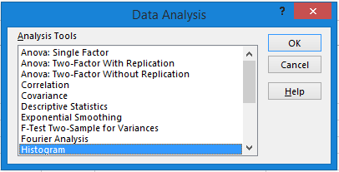
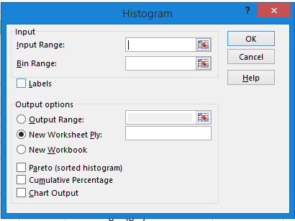
Do-it-with-me: Data Analysis → Histogram
Step 2: Go to the Tab “Data”, clink “Data Analysis” at the right top corner
1
2
Step 3: Window “Data Analysis” will pop up, select “Correlation” and click “Ok”.
Step 4: Window “Histogram” will pop up

Slide 32
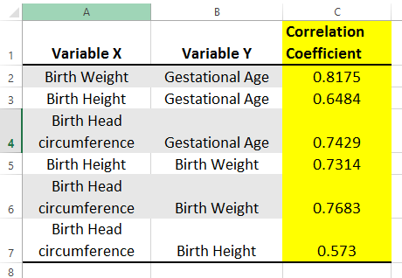
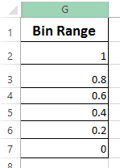
Input Range and Bin Range
Input Range
Put all the correlation coefficient in one column C ( Column A and B are optional)
Bin Range
Refer to the rules of thumb for different strength of correlation

Slide 33


Do-it-with-me: Histogram
Step 5: Select Input Range by click the button shown in the red circle
Step 6: Select the data range “C1: C7” by covering the cells from C1 to C7
Step 7: click the button in the red circle again to allow the range being selected
Step 8: Do the same for the Bin Range G1 to G6
Step 9: Tick “Labels”
Step 10: Output Option is “Output Range”. Click the button in the red circle and select a blank cell in the current worksheet as the place to put the correlation analysis result
Step 11: Click “Ok”

Slide 34



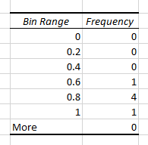
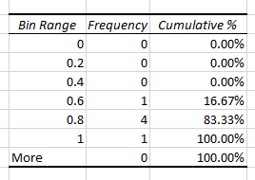
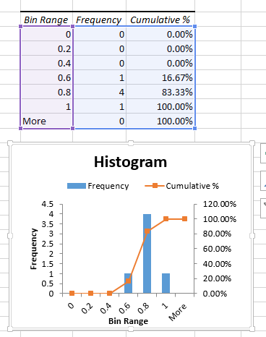

Display Options
A | B | C
Explore the option D by yourself

Slide 35
Understanding the Histogram
5 out of 6 pairs of variables have strong or very strong positive correlation
The remaining 1 pair of variables also has a moderate correlation
In conclusion, all the 4 variables tend to increase or decrease at the same time

Slide 36
Exercise
Plot a histogram for the MSA results of one class based on the bin range stated below.
Grade | Bin Range
F | 19
E | 24
D | 29
C | 34
B | 39
A | 50
MSA Result
17
19
21
22
25
25
27
28
30
31
32
32
33
34
34
37
39
39
39
40
42
44
45
46
48
Question: Why is the Bin Range not set as
Grade | Bin Range
F | 20
E | 25
D | 30
C | 35
B | 40
A | 50

Slide 37
Exercise - Answer
Bin Range | Frequency | Cumulative %
19 | 2 | 8.00%
24 | 2 | 16.00%
29 | 4 | 32.00%
34 | 7 | 60.00%
39 | 4 | 76.00%
50 | 6 | 100.00%
More | 0 | 100.00%
How to display Grade A, B, C, etc., instead of 50,39, 34, etc.?

